Slide 1
Ancient Olympia

Slide 2
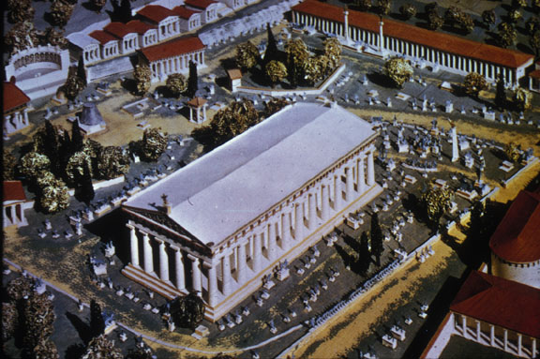
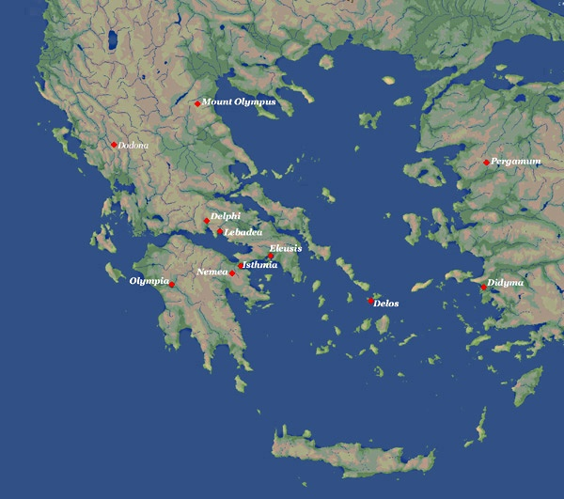
Sanctuary of Zeus at Olympia
Panhellenic Sanctuary Panhellenic = all Greeks

Slide 3
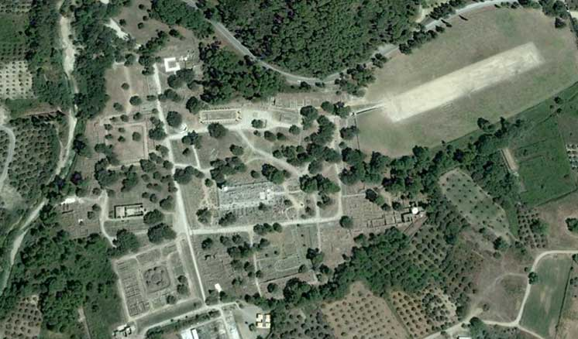
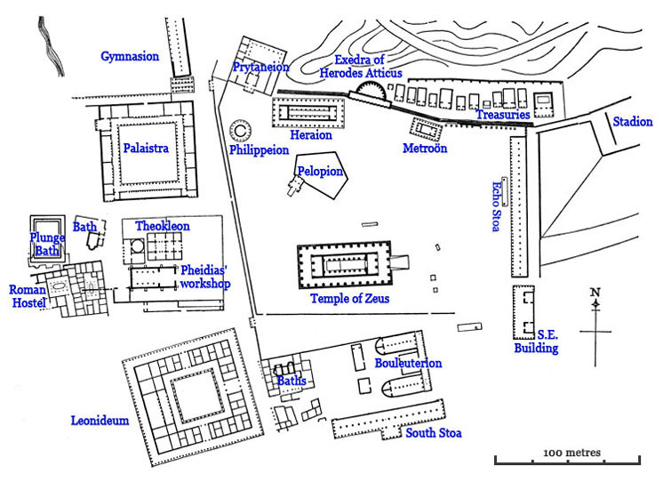
Plan of the Sanctuary

Slide 4
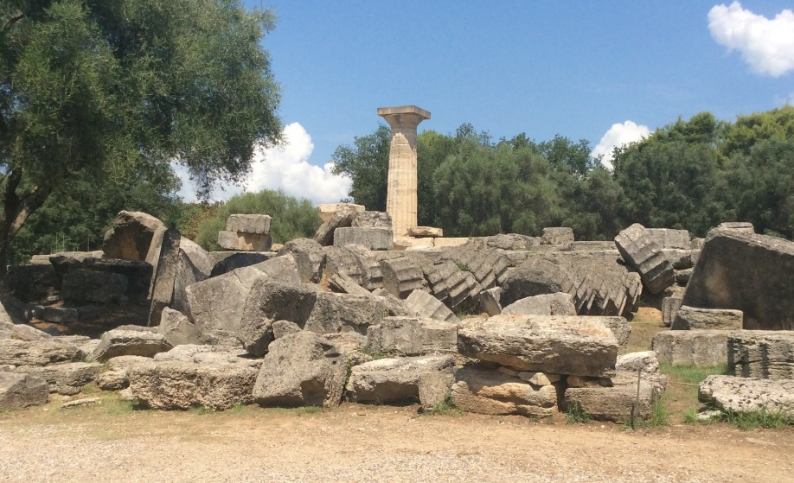
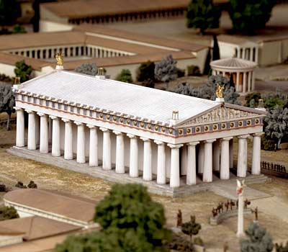
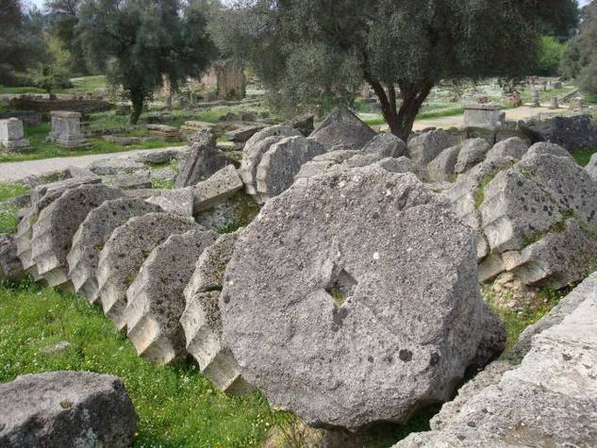
Temple of Zeus

Slide 5
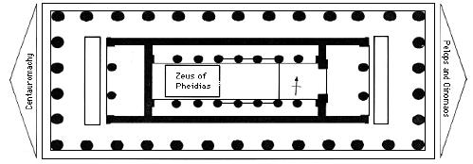
A big statue of Zeus was in a room inside the Temple

Slide 6
“The god is seated on a throne. He is made of gold and ivory, and on his head is a wreath representing sprays of olive. In his right hand stands a figure of Victory, also of gold and ivory … in his left hand is a sceptre, skilfully wrought from a variety of metals. The bird perched on the sceptre is an eagle. The sandals of the god are of gold, and so is his robe, which is decorated with animals and lilies. The throne is adorned with gold, precious stones, ebony and ivory; it is painted and carved with figures … I know that the measurements of height and breadth of Zeus at Olympia have been recorded, but I cannot commend the men who took the measurements, for their information falls far short of the impression which the image makes on the spectator.”
Pausanias V II.I-2,9

Slide 7
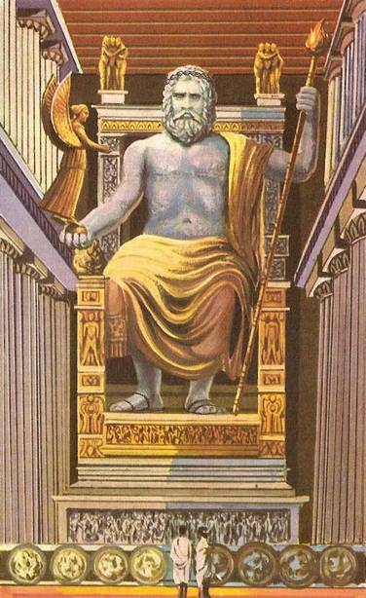
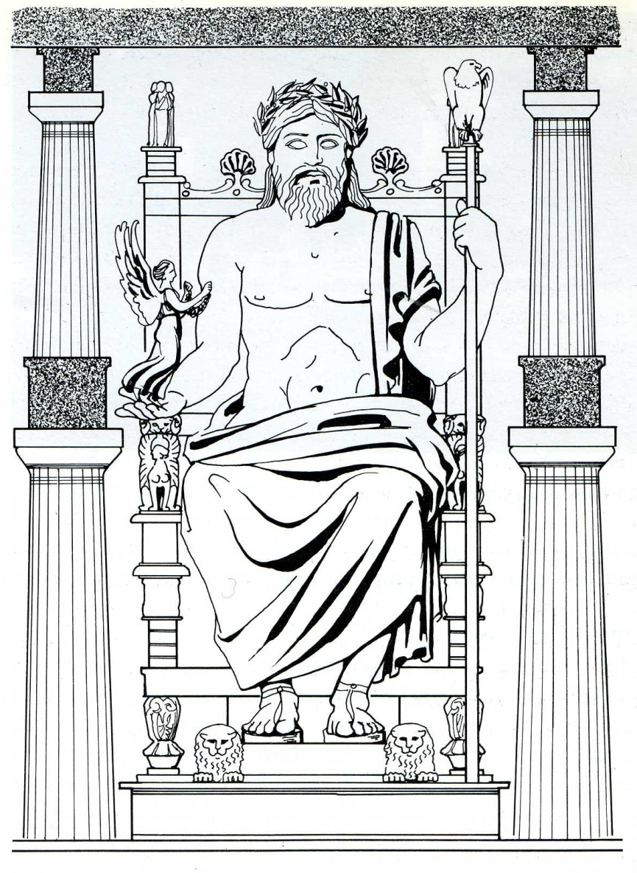
Cult statue of Zeus
Chryselephantine = ivory and gold

Slide 8
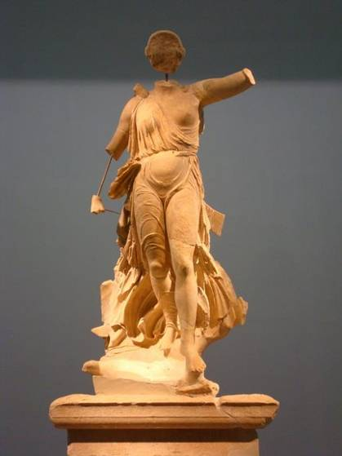
Statue of Nike

Slide 9
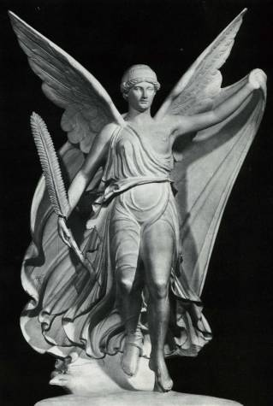
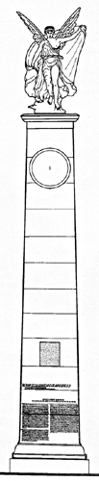
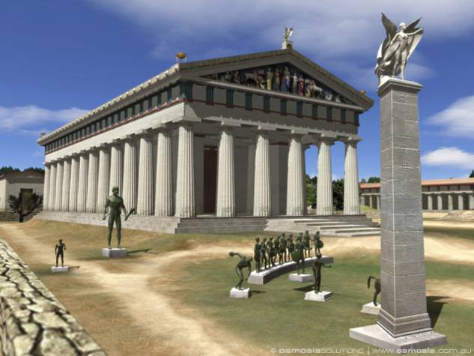
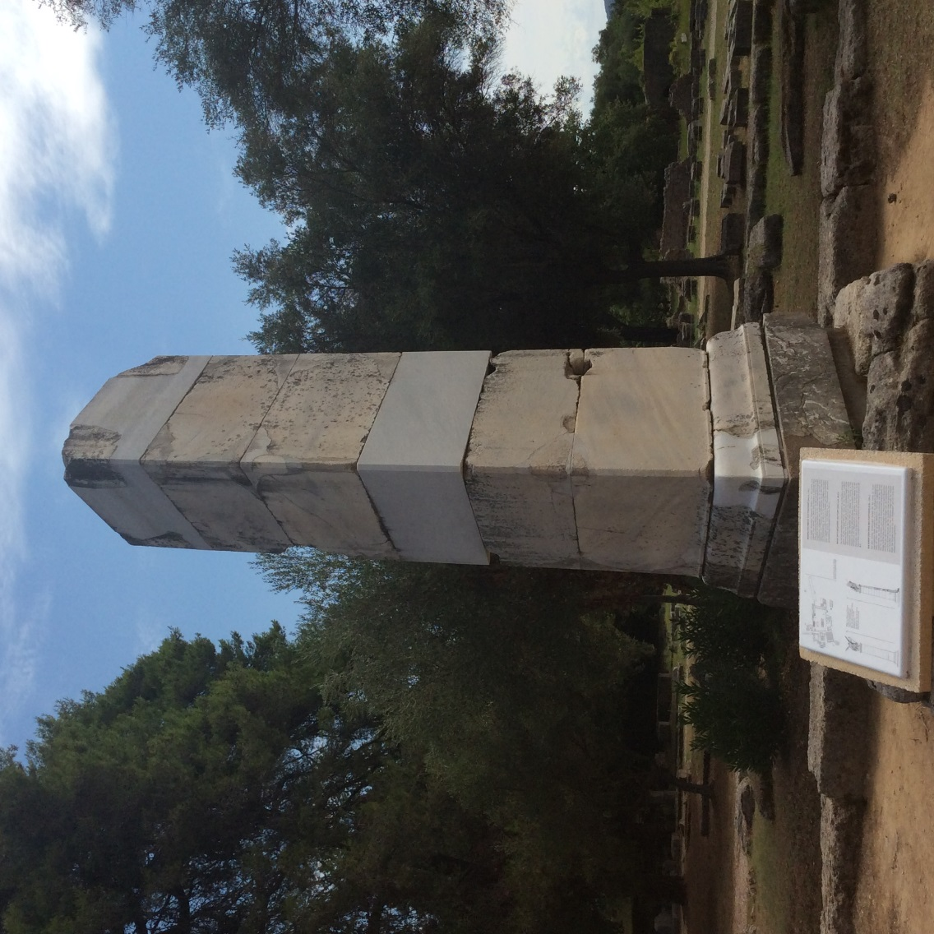

Slide 10
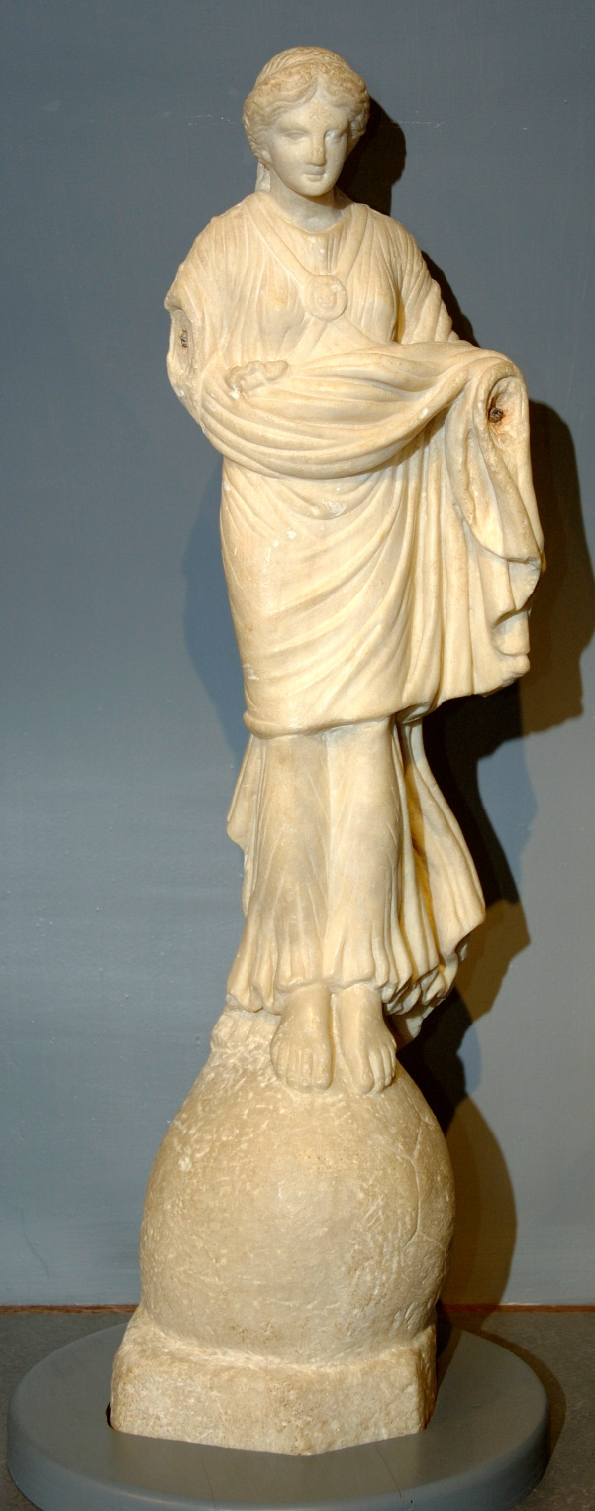
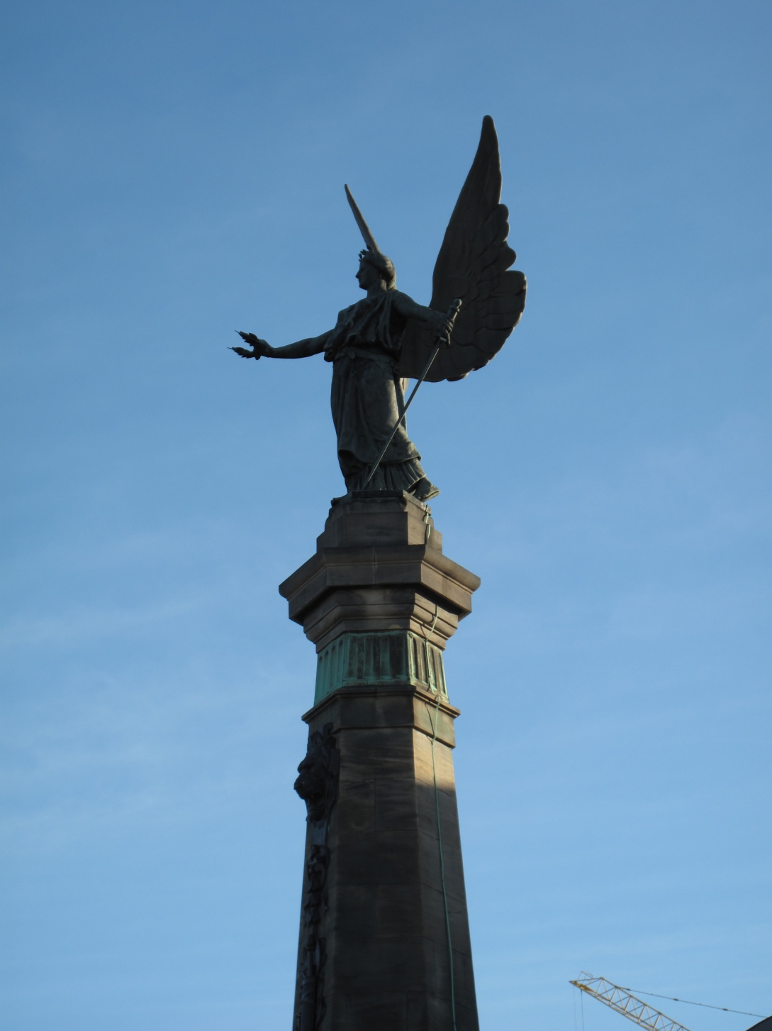

Slide 11
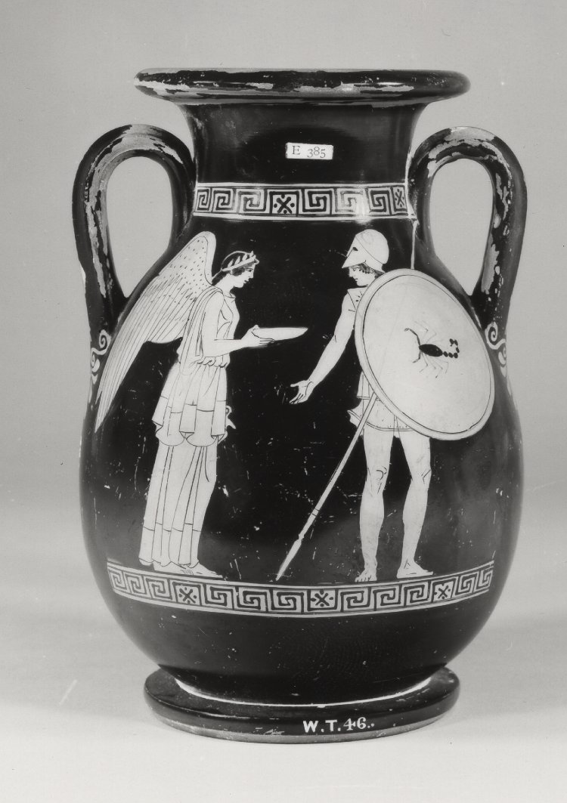
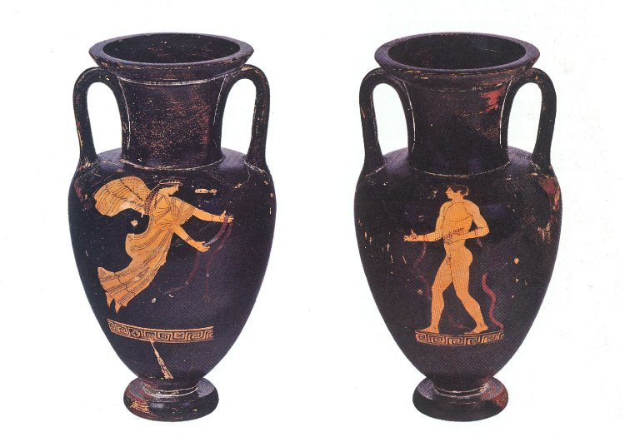

Slide 12
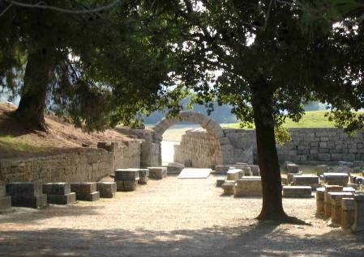
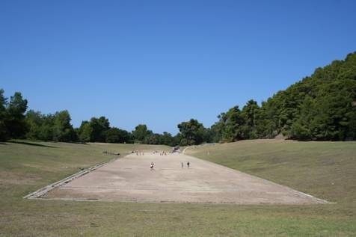
Stadium

Slide 13
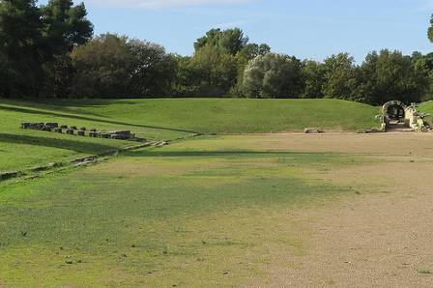
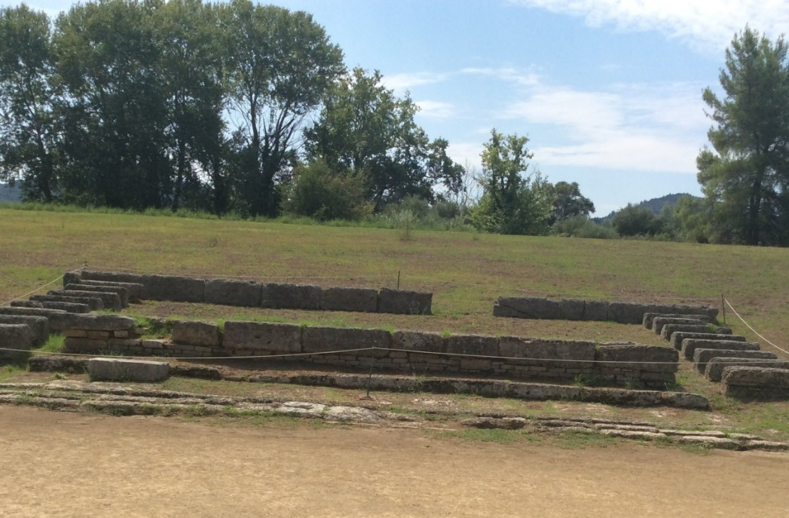
Judges’ Seats

Slide 14
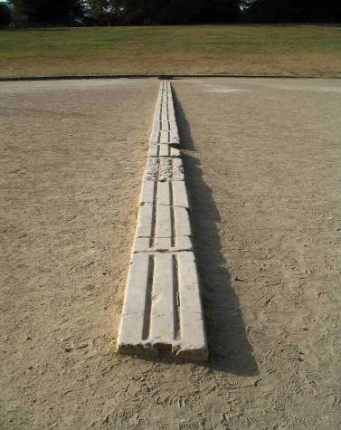
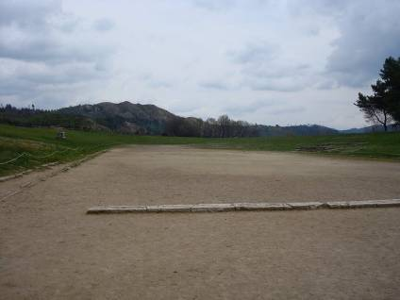
Starting Line

Slide 15
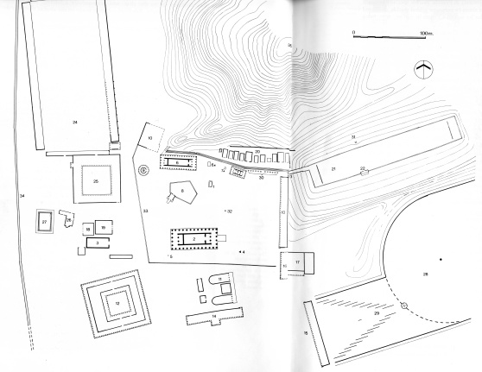
Hippodrome

